Slide 1
RideGO
Presented By:
Rokibul Hasan (011193040)
Md. Mansurul Haque (011202034)
Md Rajib Hossen (011191244)
Emam Hasan (011201302)
Muminul Islam (011202115)

Slide 2
Short Description
RideGO is a straightforward web application that allows student to share a ride from one location to another for a reasonable fee.

Slide 3

Research Papers

Slide 4
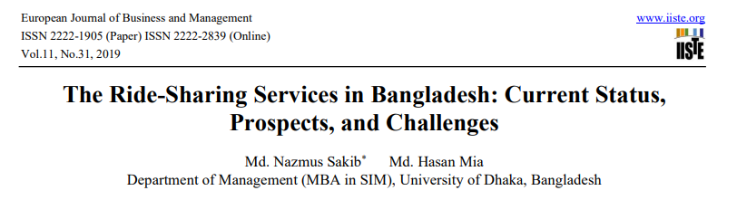
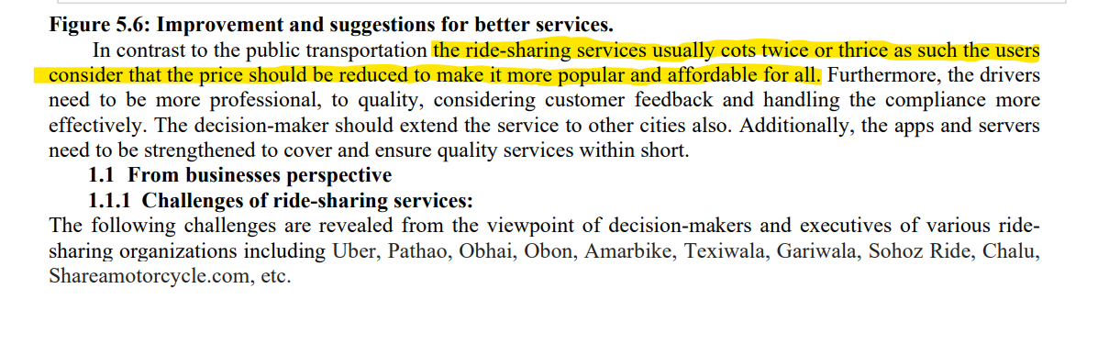
Research Paper
https://link.springer.com/article/10.1186/s12544-021-00522-1

Slide 5
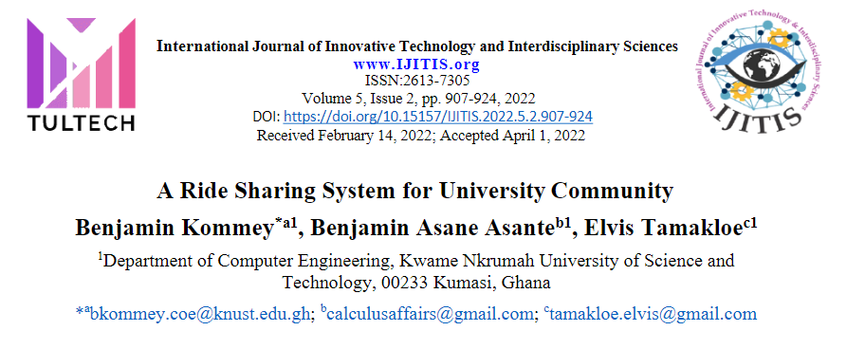
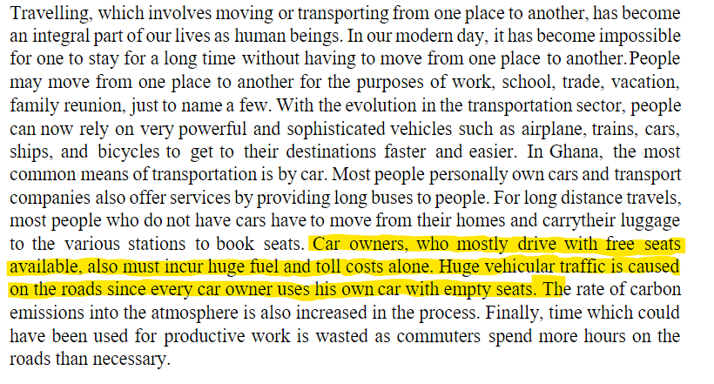
Research Paper

Slide 6
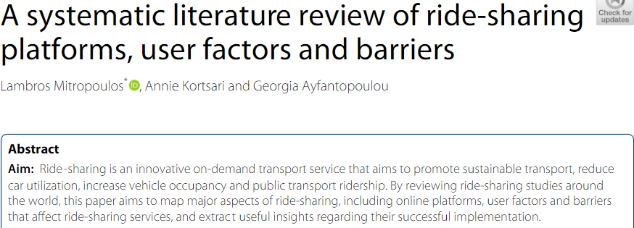
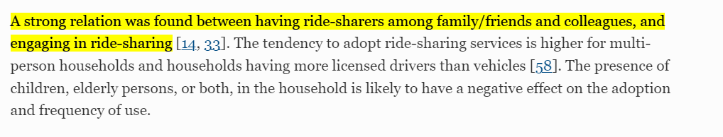
Research Paper

Slide 7

Online Articles

Slide 8
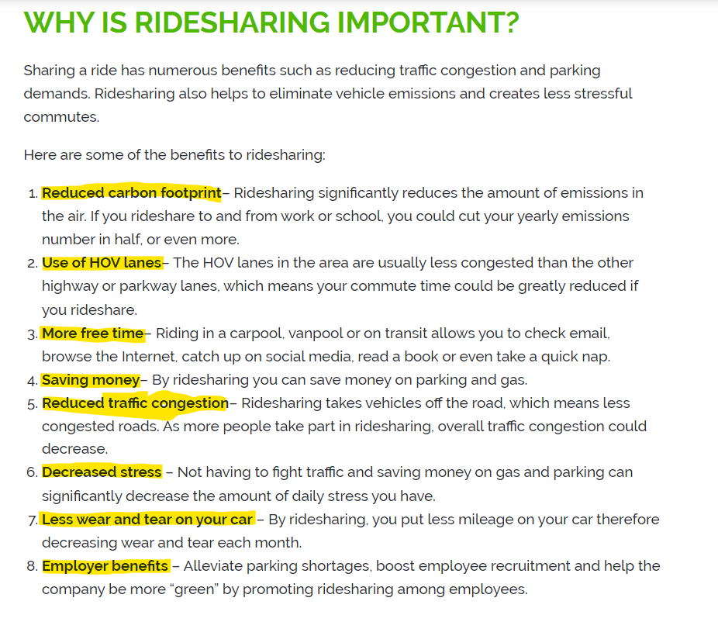
Online Article

Slide 9
Benchmark Analysis

Slide 10






Benchmark Website/ Apps

Slide 11
Comparison Chart
 | GPS and Location Determination | Booking Rides Ahead of Time | Cancellation Policies and Methods | Searching for a Driver | Receiving Real-time Notification | Only University/ College/ School Service | Extra Charge | Live Chat
Uber | Yes | Yes | Yes | Yes | Yes | No | Yes | No
Pathao | Yes | No | Yes | Yes | Yes | No | Yes | No
MUV | Yes | No | Yes | Yes | Yes | No | Yes | No
O Bhai | Yes | No | Yes | Yes | Yes | No | Yes | No
Shohoz | Yes | No | Yes | Yes | Yes | No | Yes | No
RideGo | Yes | Yes | Yes | No | Yes | Yes | No | Yes
Features
Product

Slide 12
Gap Analysis
We have read a bunch of articles related to our project . We found some information and gaps among them.
1. There is no known platform for Student only Ride Sharing Service.
2. Some of the service are more costly.
3. There is no such type of “Live Chat” option with all user.
4. They focus on all user but we will focus only on ‘students’.

Slide 13
Features List
Those are –
Student Verification.
Auto Suggestion Searching.
Live chat support with all user.
Rate/Feedback.
Live Location Sharing
Pick Up Point
Booking Rides Ahead of Time

Slide 14
RideGO
RideGO has 2 stakeholders.
Rider.
Passenger.

Slide 15
Context Diagram
Admin
0
Ride go
Rider
Driver

Slide 16




Use case DIagram
Ride Go System
User Manual
Vehicle
Registration
Vehicle
Rider
Ride Sharing Management
Driver
Admin

Slide 17

Thank You

